Slide 1

PPI 3D complex prediction and interfaces
(What we talk about when we talk about docking)
Allegra Via
Institute of Molecular Biology and Pathology
National Research Council, Italy

Slide 2
How PPI surfaces can be studied?
Experimental:
The most significant contribution to understanding the PPI surface comes from structural biology via X-ray crystallography or NMR as well as mutational studies
Computational:
Prediction of interaction/binding sites
Prediction of protein-protein complexes
In silico mutational studies

Slide 3
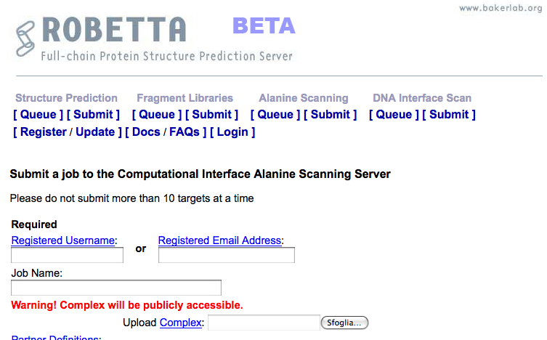
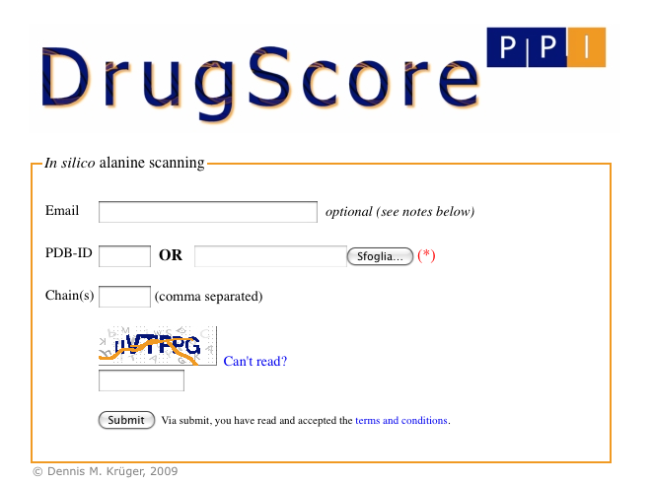
Computational alanine-scanning in protein-protein interfaces
http://robetta.bakerlab.org/alascansubmit.jsp
http://cpclab.uni-duesseldorf.de/dsppi/
DrugScorePPI and Robetta Alascanning are dedicated to the identification of hot spots at protein-protein interfaces

Slide 4
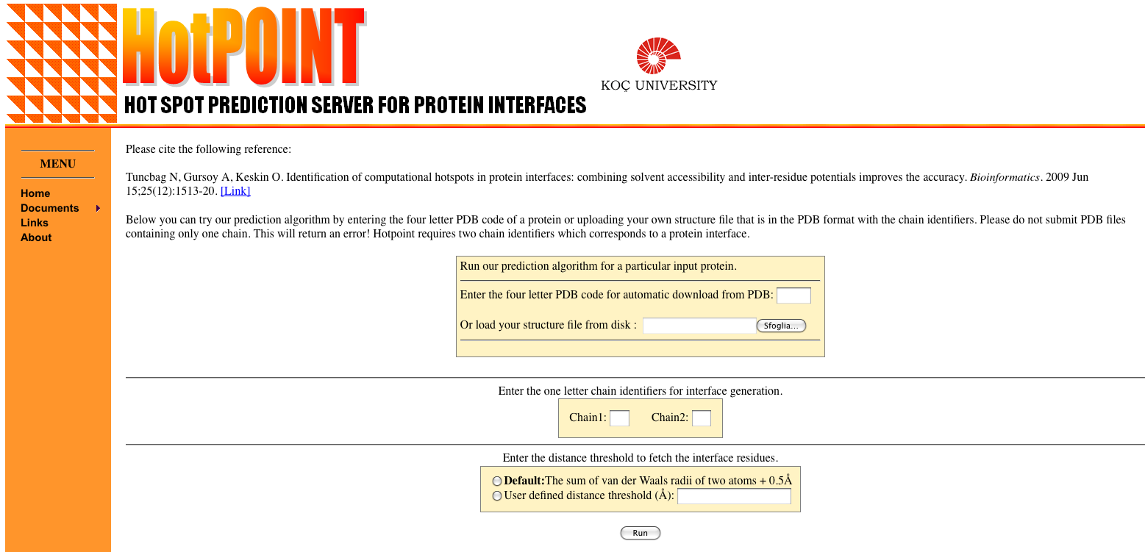
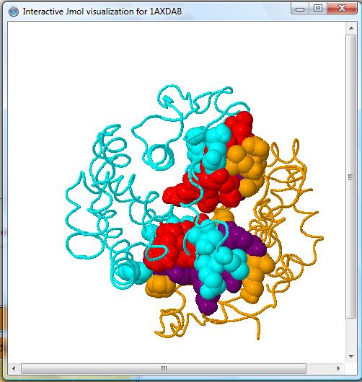
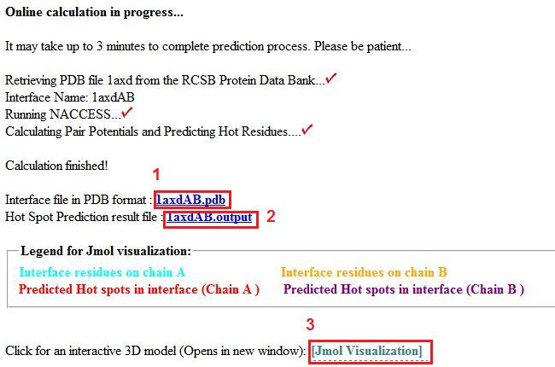
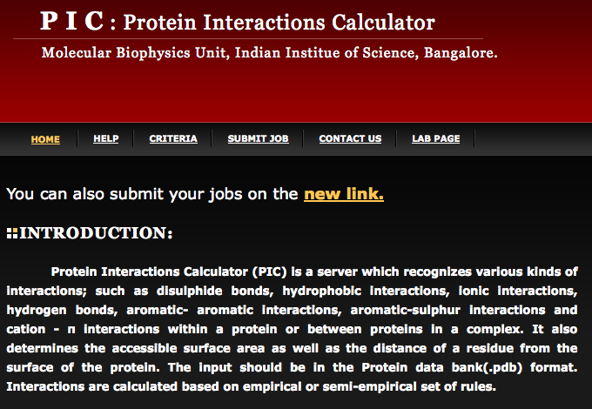
http://prism.ccbb.ku.edu.tr/hotpoint/
HotPOINT calculates solvent accessibilities and total contact potentials. It predicts hot spots at the complex interface
http://crick.mbu.iisc.ernet.in/~PIC/
PIC recognises various kinds of interactions, such as disulphide bonds, hydrophobic interactions, ionic interactions, hydrogen bonds, aromatic- aromatic interactions, aromatic-sulphur interactions and cation-π interactions between proteins in a complex

Slide 5
Prediction of protein-protein interactions
Phylogenetic profiling
Prediction of co-evolved protein pairs based on similar phylogenetic trees
Rosetta stone method
Association methods
Bayesian network modelling
Domain-pair exclusion analysis
Supervised learning problem
Gene fusion
Classification methods
Inference of interactions from homologous structures
Identification of structural patterns (e.g. hot spots)
Protein-protein docking
3D

Slide 6
Hexameric PilT motor protein complex from P. Aeruginosa
PDB: 3JVV
http://www.ebi.ac.uk/pdbe/about/news/powerful-little-motor

Slide 7
Why predicting protein complexes?

Slide 8
Interface of the PilT domains with arginine residues shown in orange sticks and ATP analog shown in green

Slide 9
Molecular docking

Slide 10
Molecular docking: an optimisation problem

Slide 11
DOCKING = put a ligand in the pocket ( = best torsions) + maximise its affinity
Step 1: Pose generation
Conformational space search
Step 2: Scoring
Ranking of potential solutions

Slide 12
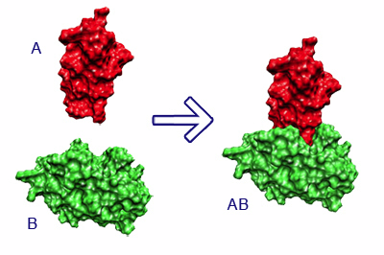
The docking problem
Given the atomic coordinates of two molecules, predict their “correct” bound association
receptor
receptor-ligand complex
ligand

Slide 13
Which ligands?

Slide 14
Protein-ligand interactions
elemental ions
small molecules
peptides
macromolecules

Slide 15
Three classes of docking
Protein-small molecule
Lot of flexibility
Binding sites tend to be small and deep
Protein-peptide
8-10 amino acids
Floppy backbones
Protein-protein
Stable backbones
Binding interfaces tend to be large and flat

Slide 16
Protein-protein docking: modelling the structure of protein complexes
Used to model protein complexes
It is the “gold standard” for prediction of PPIs
It makes it possible to figure out how the interaction takes place ("mode" of binding)
It is computationally very challenging and thus very unlikely to be applied for high throughput purposes
Ngounou Wetie et al. Proteomics, 2013

Slide 17
What types of questions can docking address?
If receptor and ligand do bind in vivo:
What is the spatial configuration they adopt in their bound state?
What is the structure of the protein complex (near-native structure) in atomic details ?
How strong or weak is their interaction (= which types of interactions are present)?
What is the orientation that maximises the interaction, minimising the energy of the complex?
If they don't bind:
Would they bind if there was a mutation?

Slide 18
Where do we start?

Slide 19
Ideally: a GOOD crystal structure
Usually worse: a homology model
A ligand, usually: the co-crystallised molecule

Slide 20
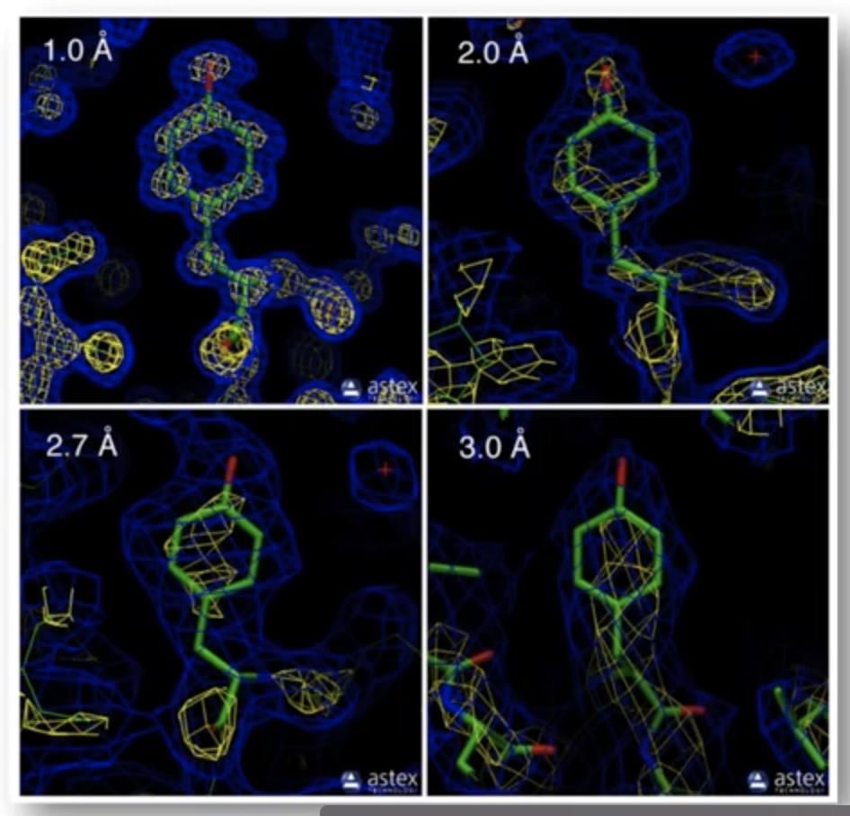
Ideally: a GOOD crystal structure
Usually worse: a homology model
A ligand, usually: the co-crystallised molecule

Slide 21
Ideally: a GOOD crystal structure
Usually worse: a homology model
A ligand, usually: the co-crystallised molecule

Slide 22
Ideally: a GOOD crystal structure
Usually worse: a homology model
A ligand, usually: the co-crystallised molecule
Please remember: an X-RAY/PDB structure is also just a «modelled» snapshot by a crystallographer
there is human intervention… not the holy experimental truth

Slide 23
The PDB educational portal
https://pdb101.rcsb.org/learn/guide-to-understanding-pdb-data/introduction

Slide 24
Ideally: a GOOD crystal structure
Usually worse: a homology model
A ligand, usually: the co-crystallised molecule

Slide 25
Ideally: a GOOD crystal structure
Usually worse: a homology model
A ligand, usually: the co-crystallised molecule
Bound docking: artificial separation of receptor and ligand
Goal: reconstruct the native complex

Slide 26
Ideally: a GOOD crystal structure
Usually worse: a homology model
A ligand, usually: the co-crystallised molecule
Bound docking: artificial separation of receptor and ligand
Goal: reconstruct the native complex
No conformational changes are involved
Used as first test to validate the algorithm

Slide 27
«Unbound» or «predictive» modelling
reconstruct a complex using the unbound structures of the receptor and the ligand
Halperin et al. Proteins, 2002

Slide 28
An "unbound" structure may be:
native
pseudo-native
modelled
Native: “free in solution”, in its uncomplexed state
Pseudo-native: structure complexed with a molecule different from the one used for the docking
Halperin et al. Proteins, 2002

Slide 29
Unbound docking is far more complex than bound docking
What are the issues?

Slide 30
conformational changes (side-chains and backbone movements)
experimental errors in the structures
reliability of models
computing power

Slide 31
Step 1: Pose generation
Conformational space search
Step 2: Scoring
Ranking of potential solutions

Slide 32
Another key ingredient in docking
Representation of the system

Slide 33
Representation of the system
Docking essentially simulates the interaction of the protein surface
How do we define a protein surface?
Mathematical models (e.g. geometrical shape descriptors, a grid)
Static or dynamic treatment of the protein frame (rigid vs flexible)

Slide 34
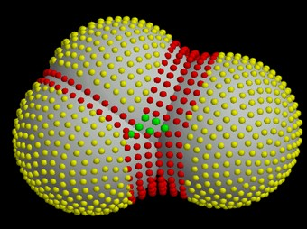
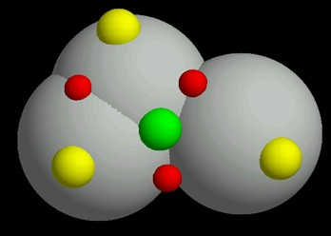
Surface representation
Dense surface (Connolly)
Sparse surface (Shuo Lin et al.)
The choice of the system (surface) representation decides the types of conformational search algorithms, and the ways to rank potential solutions
http://www.chem.leeds.ac.uk/ICAMS/eccc/cangaroo.html

Slide 35
Step 1: Pose generation
Conformational space search
OR
Getting the ligand into the pocket
Translation & Rotation of ligand needs to be performed
=> An optimisation problem in T and R space

Slide 36
Bond distances & angles in principle known BUT torsions will have to adapt to put the ligand into the pocket
How the conformation will look like?
=> An optimisation problem in T space

Slide 37
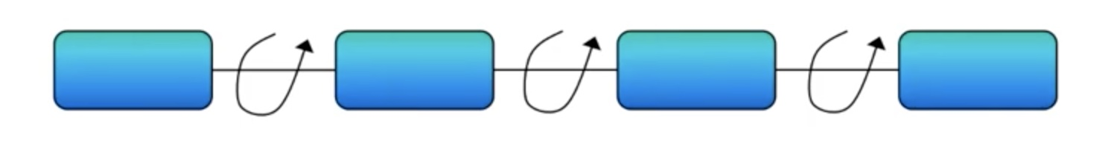
Conformational space search: torsions will kill us!
100 valid angles => 100³ = 1.000.000 points to evaluate it
Let’s assume: 1 sec per evaluation…
1.000.000/60 = 16.666 mins = 278 hrs = 11 days

Slide 38
Rigid vs flexible docking
Rigid body - highly simplistic model - receptor & ligand two rigid solid bodies
Semi-flexible - ligand flexible, receptor rigid
Flexible docking – both molecules flexible, BUT flexibility is limited or simplified

Slide 39
Rigid vs flexible docking
Rigid body - highly simplistic model - receptor & ligand two rigid solid bodies
Semi-flexible - ligand flexible, receptor rigid
Flexible docking – both molecules flexible, BUT flexibility is limited or simplified

Slide 40
Rigid vs flexible docking
Rigid body - highly simplistic model - receptor & ligand two rigid solid bodies
Semi-flexible - ligand flexible, receptor rigid
Flexible docking – both molecules flexible, BUT flexibility is limited or simplified

Slide 41
Docking algorithms
Rigid docking
fast → can explore the entire receptor and ligand surfaces
Less accurate
flexibility = "soft" belt into which atoms can penetrate
Flexible docking
Slower
More accurate
Can model side-chain/backbone flexibility
highly reliable but too slow for extensive ligand docking

Slide 42
Conformational space search
Efficient search algorithm – fast and effective in covering the relevant conformational space
Computationally difficult - there are many ways to put two molecules together
Goal: locate the most stable state (global minimum) in the energy landscape

Slide 43
Search algorithms
scan of the entire solution space in a predefined systematic manner
2) gradual guided progression through solution space Only part of the solution space is searched, or fitting solutions* are generated.
3) data-driven docking – uses the available information about binding site/interface residues
* Solutions meeting pre-defined criteria
Notes:
A key to the success of rigid body methods is that the shape complementarity term allows for some overlaps, and hence the methods are able to tolerate moderate differences between bound and unbound (separately crystallized) structures.
Rigid body methods including PIPER perform exhaustive sampling of the conformational space on a dense grid, and hence certainly sample some near-native structures. However, the need for tolerating some steric clashes due to docking unbound protein structures requires the use of approximate scoring functions, and reducing sensitivity to conformational differences also reduces specificity. Therefore, the docked conformations that are close to the native structure do not necessarily have the lowest energies, whereas low energy conformations may occur far from the X-ray structures.

Slide 44
A search algorithm may produce an immense number of solutions (10⁹)

Slide 45
Ranking of potential solutions
Scoring functions
Prediction of the interaction energy / binding affinity of each conformer of the ligand docked
Notes:
Scoring functions are mathematical functions used to approximately predict the binding affinity between two molecules after they have been docked.
Scoring functions are normally parameterized (or trained) against a data set consisting of experimentally determined binding affinities between molecular species similar to the species that one wishes to predict.
For currently used methods aiming to predict affinities of ligands for proteins the following must first be known or predicted:
Protein tertiary structure – arrangement of the protein atoms in three-dimensional space. Protein structures may be determined by experimental techniques such as X-ray crystallography or solution phase NMR methods or predicted by homology modelling.
Ligand active conformation – three-dimensional shape of the ligand when bound to the protein
Binding-mode – orientation of the two binding partners relative to each other in the complex
The above information yields the three-dimensional structure of the complex. Based on this structure, the scoring function can then estimate the strength of the association between the two molecules in the complex using one of the methods outlined in the following.

Slide 46
Force field
classical
Empirical
Knowledge-based
Scoring functions
data-driven
Machine-learning
Notes:
Different programs use different force fields
The first three types, force-field, empirical and knowledge-based, are commonly referred to as classical scoring functions and are characterized by assuming their contributions to binding are linearly combined. Due to this constraint, classical scoring functions are unable to take advantage of large amounts of training data.
In machine-learning scoring functions the functional form is inferred directly from the data.

Slide 47
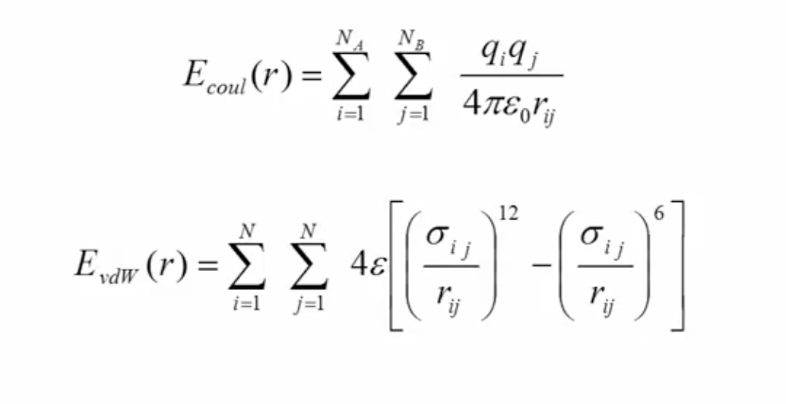
Force field-based scoring functions
Force field is a set of parameters that define the potential energy of a system
They are based on molecular mechanics and estimate the interaction energy between receptor and ligand
Notes:
Force field – affinities are estimated by summing the strength of intermolecular van der Waals and electrostatic interactions between all atoms of the two molecules in the complex using a force field. The intramolecular energies (also referred to as strain energy) of the two binding partners are also frequently included. Finally since the binding normally takes place in the presence of water, the desolvation energies of the ligand and of the protein are sometimes taken into account using implicit solvation methods such as GBSA or PBSA

Slide 48
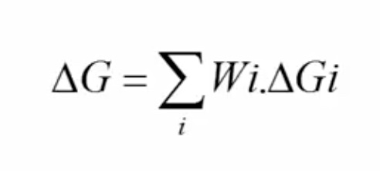
Empirical-based scoring functions
They have simple energy terms and are faster
Hydrogen bonds, ionic interactions, hydrophobic interactions, aromatic interactions, number of rotable bonds
The binding affinity is usually measured as empirical (weighted) sum of all such interactions
Notes:
Empirical – based on counting the number of various types of interactions between the two binding partners. Counting may be based on the number of ligand and receptor atoms in contact with each other or by calculating the change in solvent accessible surface area (ΔSASA) in the complex compared to the uncomplexed ligand and protein. The coefficients of the scoring function are usually fit using multiple linear regression methods. These interactions terms of the function may include for example:
hydrophobic — hydrophobic contacts (favorable),
hydrophobic — hydrophilic contacts (unfavorable) (Accounts for unmet hydrogen bonds, which are an important enthalpic contribution to binding. One lost hydrogen bond can account for 1–2 orders of magnitude in binding affinity),
number of hydrogen bonds (favorable contribution to affinity, especially if shielded from solvent, if solvent exposed no contribution),
number of rotatable bonds immobilized in complex formation (unfavorable conformational entropy contribution).

Slide 49
Knowledge-based scoring functions
based on statistical observations of intermolecular close contacts in large 3D databases
Statistical observations are used to derive statistical "potentials of mean force"
Notes:
Knowledge-based – based on statistical observations of intermolecular close contacts in large 3D databases (such as the Cambridge Structural Database or Protein Data Bank) which are used to derive statistical "potentials of mean force". This method is founded on the assumption that close intermolecular interactions between certain types of atoms or functional groups that occur more frequently than one would expect by a random distribution are likely to be energetically favorable and therefore contribute favorably to binding affinity.

Slide 50
Machine-learning scoring functions
Do not assume a predetermined functional form for the relationship between binding affinity and the structural features describing the protein-ligand complex
The functional form is inferred directly from the data
Notes:
Machine-learning – Unlike classical scoring functions, machine-learning scoring functions are characterized by not assuming a predetermined functional form for the relationship between binding affinity and the structural features describing the protein-ligand complex.[ In this way, the functional form is inferred directly from the data. Machine-learning scoring functions have consistently been found to outperform classical scoring functions at binding affinity prediction of diverse protein-ligand complexes. This has also been the case for target-specific complexes, although the advantage is target-dependent and mainly depends on the volume of relevant data available. When appropriate care is taken, machine-learning scoring functions tend to strongly outperform classical scoring functions at the related problem of structure-based virtual screening. Furthermore, if data specific for the target is available, this performance gap widens.

Slide 51
Ideally, the best search algorithms and scoring schemes should be combined
Two-stage ranking:
fast scoring to rapidly scan possible solutions and obtain initial "good" candidates – mostly geometric criteria
Followed by more advanced methods to further discriminate the limited conformations - energy criteria
Binding site information (known or predicted) may be included in scoring

Slide 52
Kozakov et al, Biophys J, 2005
Clustering of solutions
Events that occur in clusters are probably not random

Slide 53
Kozakov et al, Biophys J, 2005
Clustering of solutions
The cluster with the largest number of low-energy structures is typically the native fold, the center of the most populated cluster being a structure near the native binding site

Slide 54
Kozakov et al, Biophys J, 2005
Clustering of solutions
Looking for large clusters is a major tool of finding near-native conformations

Slide 55
Challenges & limitations 1
Accurate prediction of ligand-receptor binding energy is still a challenge

Slide 56
Challenges & limitations 2
The process of choosing an appropriate scoring function and algorithm for a specific receptor and ligand is tricky

Slide 57
Challenges & limitations 3
Taking protein flexibility into account is not easy
Proteins are flexible and may undergo even large conformational changes upon binding

Slide 58
Challenges & limitations 4
Desolvation penalty and conformational energy costs are not addressed clearly in most of the scoring functions available

Slide 59
Challenges & limitations 5
Results are generally poor with weakly interacting proteins

Slide 60
Challenges & limitations 6
Accurate interaction energies are too complicated to compute

Slide 61
Conclusions
The molecular docking problem is far from being solved, BUT…
If the conformational change is limited to surface side-chain atoms, rigid body algorithms have been remarkably successful
Integration of experimental information produces reliable results
Relatively easy for enzyme-inhibitor complexes
Sometimes good results with antigen-antibody pairs

Slide 62
Conclusions
The molecular docking problem is far from being solved, BUT…
If the conformational change is limited to surface side-chain atoms, rigid body algorithms have been remarkably successful
Integration of experimental information produces reliable results
Relatively easy for enzyme-inhibitor complexes
Sometimes good results with antigen-antibody pairs

Slide 63
Conclusions
The molecular docking problem is far from being solved, BUT…
If the conformational change is limited to surface side-chain atoms, rigid body algorithms have been remarkably successful
Integration of experimental information produces reliable results
Relatively easy for enzyme-inhibitor complexes
Sometimes good results with antigen-antibody pairs

Slide 64
Conclusions
The molecular docking problem is far from being solved, BUT…
If the conformational change is limited to surface side-chain atoms, rigid body algorithms have been remarkably successful
Integration of experimental information produces reliable results
Relatively easy for enzyme-inhibitor complexes
Sometimes good results with antigen-antibody pairs

Slide 65
Conclusions
The molecular docking problem is far from being solved, BUT…
If the conformational change is limited to surface side-chain atoms, rigid body algorithms have been remarkably successful
Integration of experimental information produces reliable results
Relatively easy for enzyme-inhibitor complexes
Sometimes good results with antigen-antibody pairs

Slide 66
Conclusions
Despite some algorithms are able to rank correct solutions within the top ten predictions, for most complexes the highest ranked structures are still false positives (high rmsd from the complex)
No efficient method for reliable discrimination between correct solutions and FPs is currently available, in particular if the binding site is unknown
Many FPs displaying good surface complementarity are far from the native complex

Slide 67
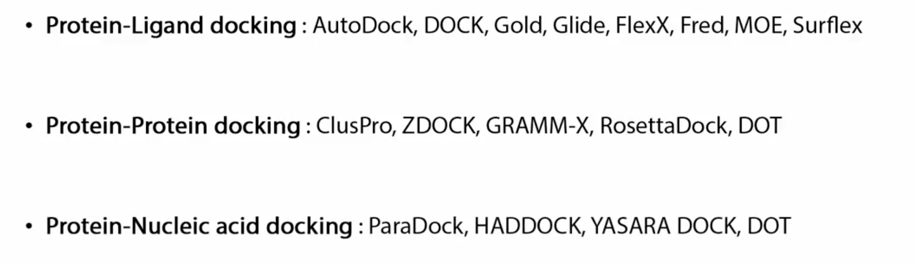
How can you choose a docking program?

Slide 68
How can you choose a docking program?
Who is the receptor?
Who is the ligand?
Is it free?
Is it difficult to use?
How does it perform?
Search algorithm?
Scoring function?

Slide 71
ClusPro http://nrc.bu.edu/cluster
The first fully automated, web-based program for the computational docking of protein structures
The docking algorithms evaluate billions of putative complexes, retaining a preset number with favorable surface complementarities
A filtering method is then applied to this set of structures, selecting those with good electrostatic and desolvation free energies for further clustering
The program output is a short list of putative complexes ranked according to their clustering properties

Slide 72
ClusPro http://nrc.bu.edu/cluster
User Input: PDB files of the 2 protein structures
Output: 10 (default) top predictions of docked conformations close to the native structure
Rigid body docking is performed using 2 established FFT-based docking programs (DOT and ZDOCK)
The scoring is solely based on the surface complementarity between the two structures
Over 2.7 10¹⁰ structures are evaluated, retaining 20 000 structures with the best surface complementarity scores, which are then further subjected to an empirical free energy filtering algorithm

Slide 73
ClusPro http://nrc.bu.edu/cluster
The free energy of the complex structure is typically dominated by van der Waals interactions, which is a very noisy function and difficult to calculate, especially with incorrect side-chain rotamers
Therefore, other components of the binding free energy are used to account for the noise of the van der Waals energies
Desolvation free energy using the atomic contact potential (statistical measure of the desolvation free energy)
Electrostatic free energy using a Coulombic model with a distance-dependent dielectric of 4r

Slide 74
ClusPro http://nrc.bu.edu/cluster
The top 2000 energetically favorable structures are clustered on the basis of a pairwise binding site root mean squared deviation (RMSD) criterion
Clusters are then formed by selecting the ligand that has the most neighbors below a previously selected clustering radius.
The ligand with the most neighbors is the cluster center, and is the representative structure for the cluster

Slide 75
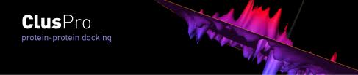
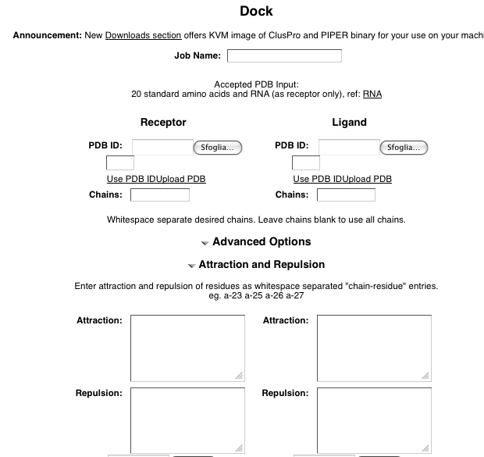

Slide 77
The HADDOCK protocol
Rigid-body docking followed by
a semi-flexible refinement of the interface in torsion angles' space (of both backbone and side-chains)
as a final stage, a Cartesian dynamics refinement in explicit solvent

Slide 78
The HADDOCK services
the Easy interface
the Prediction interface
the Expert interface (requires Expert level access)
the Refinement interface (requires Expert level access)
the Guru interface (requires Guru level access)
the Multi-body interface (requires Guru level access)
the File upload interface

Slide 79
The EASY interface

Slide 80
The EXPERT interface

Slide 81
The GURU interface

Slide 82
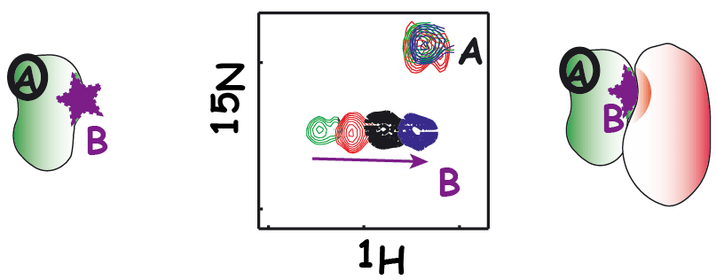
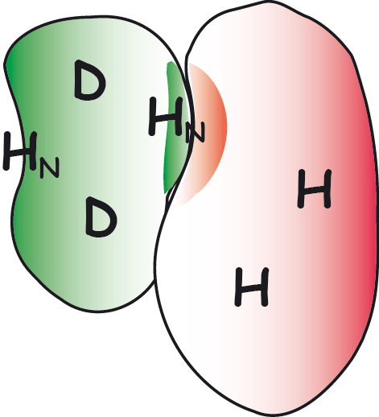
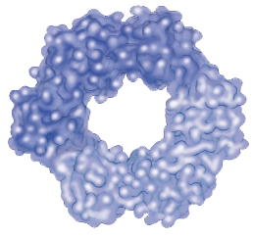
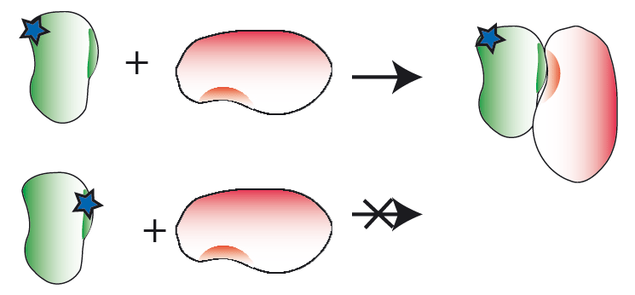
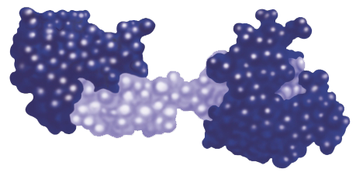
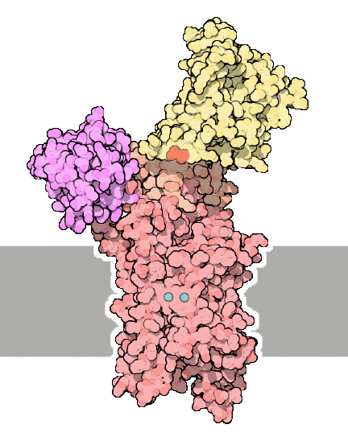
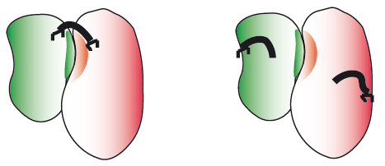
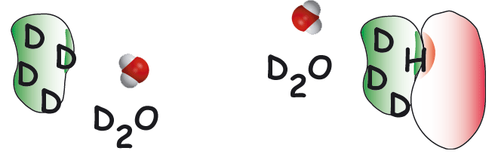
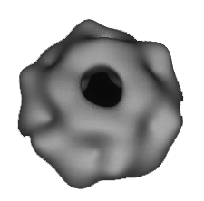
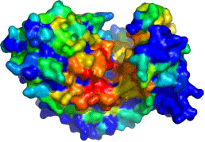
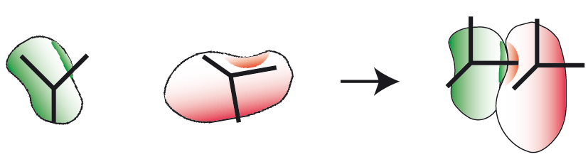
NMR titrations
NMR crosssaturation
mutagenesis
Cross-linking
HADDOCK
High Ambiguity Driven DOCKing
x
B
y
j
z
H/D exchange
A
i
k
d_{iAB}^{eff}
Other sources
e.g. SAXS, cryoEM
Bioinformatic predictions
EFRGSFSHL
EFKGAFQHV
EFKVSWNHM
LFRLTWHHV
IYANKWAHV
EFEPSYPHI
NMR anisotropy data
RDCs, para-restraints, diffusion anisotropy
http://haddocking.org; http://www.nmr.chem.uu.nl/haddock

Slide 83
Parameters supported by the various HADDOCK web interfaces
de Vries et al., Nature Protocols, 2010

Slide 84
Example of HADDOCK output
In this case additional experimental information has to be taken into account to completely rule out alternatives to the highest-scoring solution
In this case additional experimental information has to be taken into account to completely rule out alternatives to the highest-scoring solution
de Vries et al., Nature Protocols, 2010
Notes:
The top structure of the top cluster hase an interface RMSD of only 1.1 A to the first model of NMR structure. The second cluster in which oner component is 90° rotated has an HADDOCK score very similar, therefore in this case additional experimental information has to be taken into account to completely rule out alternatives to the highest-scoring solution.

Slide 85
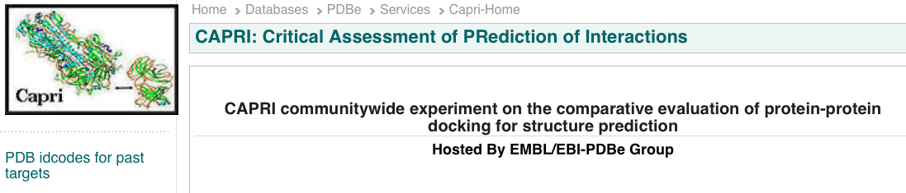
CAPRI: Critical Assessment of PRotein Interactions
http://www.ebi.ac.uk/msd-srv/capri/
CAPRI is a community-wide experiment in modelling the molecular structure of protein complexes
CAPRI is a blind prediction experiment aimed at testing the performance of protein docking methods
Rounds take place about every six months
Each round contains between one and six target protein–protein complexes whose structures have been recently determined experimentally
Targets are unpublished crystal or NMR structures of complexes, whose coordinates are held privately by the assessors, with the co-operation of the structural biologists who determined them
The atomic coordinates of the two proteins are given to groups for prediction

Slide 86

CAPRI: Critical Assessment of PRotein Interactions
The CAPRI experiment is double-blind
submitters do not know the solved structure
the assessors do not know the correspondence between a submission and the identity of its creator
International meetings
Proteins: Structure, Function, and Bioinformatics
Special CAPRI Issue: Fifth Meeting on the Critical
Assessment of Predicted Interactions
December 2013

Slide 87
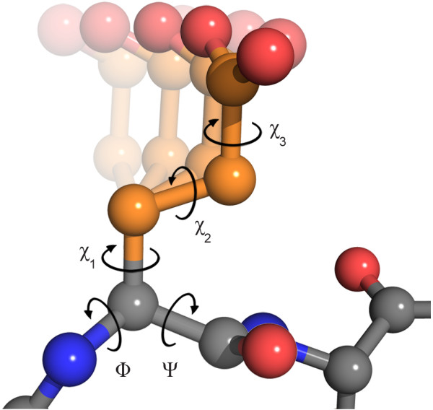
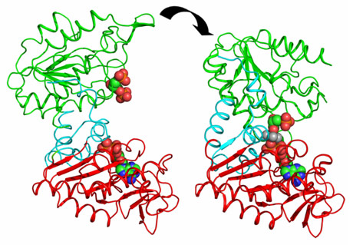
CAPRI drives the community to develop new techniques
Side-chain flexibility
First rounds the big challenge was to model correctly side-chain conformations
Dihedral angles in glutamate
Domain movements
Today the development is focused on backbone flexibilty
Domain movements in PGK catalysis.
J. Biol. Chem. (2011) 286, 14040-14048
The clustering application to protein-protein docking was first introduced in CAPRI by Camacho & Gatchell,D. (2003)

Slide 88

CAPRI experiment … who is the winner ??
There is no official ranking and in many cases the differences between the different algorithms are not huge

Slide 89
CAPRI experiment … who is the winner ??
HADDOCK (software/web server). http://haddock.chem.uu.nl
CLUSPRO (software/web server)
http://cluspro.bu.edu
ICM-pro (desktop-modeling environment)
http://www.molsoft.com/protein_protein_docking.html
ROSETTADOCK (software/web server) http://graylab.jhu.edu/docking/rosetta/
http://rosettadock.graylab.jhu.edu/submit
GRAMM-X (web server) http://vakser.bioinformatics.ku.edu/resources/gramm/grammx
PATCHDOCK/FIREDOCK (software/web server) http://bioinfo3d.cs.tau.ac.il/PatchDock/
HEX (software/web server) http://hexserver.loria.fr

